Slide 1

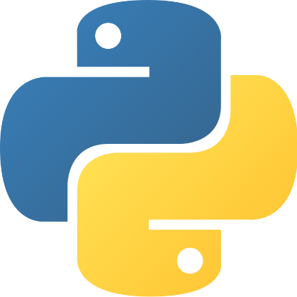
YOUTUBE VIDEO DOWNLOADER
Using Python!
- Bhavya Sehgal

Slide 2
CONTENTS
About the Project
Installing required libraries
Getting YouTube Video Metadata Information
Preparing YouTube Video Downloader Python Code
Importing libraries
Creating Display Windows
Making URL field
Creating Function to Start Downloading
Ending YouTube Video Downloader
Summary
Conclusion

Slide 3
ABOUT THE PROJECT
YouTube downloader is a GUI helper for youtube-dl. It provides a graphical interface to download videos from youtube.com with conveniences like track the download, pause, or select the media format.
Python YouTube Video Downloader is as application to download videos from YouTube. This provides users to download videos they need in their devices and watch them offline.
The object of this project is to download any type of video in a fast and easy way from YouTube in your devices

Slide 4
INSTALLING REQUIRED LIBRARIES
To implement this project we use basic concept of python, tkinter, pytube library.
Tkinter is a standard GUI library and it is one of the easiest ways to build a GUI application.
pytube used for downloading videos from youtube
To install the required modules run pip installer command on the command line:
>>>pip install youtube-downloader
>>>pip install pytube
>>>pip install pytube3
>>>pip install tkinter
>>>pip install tk

Slide 5
GETTING YOUTUBE VIDEO METADATA INFORMATION
yt.title used to print the title of the video
yt.author used to print the author of the video
yt.rating used to print the ratings given to the video
yt.views used to get the number of views of the video
yt.length used to obtain the length of the video
yt.description used to print the description that has given below the video
yt.captions used to print captions of the video
yt.streams0 used to obtain the video streams
>>>print("TITLE: ", yt.title)
>>> print("AUTHOR", yt.author)
>>> print("RATINGS GIVEN TO THIS VIDEO: ", yt.rating)
>>> print("NUMBER OF VIEWS: ", yt.views)
>>> print("LENGTH OF THIS VIDEO: ", yt.length)
>>> print("DESCRIPTION: ", yt.description)
>>> print("AGE RESTRICTION: ", yt.age_restricted)
>>> print("CAPTIONS GIVEN TO THIS VIDEO: ", yt.captions)
>>> print("THUMBNAIL URL PROVIDED: ", yt.thumbnail_url)
>>> print("STREAMS: ", yt.streams0)

Slide 6
PREPARING youtube VIDEO downloader python code
These are the following steps to build youtube video downloader project in python :
Import libraries
Create display window
Create field to enter link
Create function to start downloading

Slide 7
IMPORT LIBRARIES – Start the project by importing the required modules.
2. CREATE DISPLAY WINDOWS –
Tk() used to initialize tkinter to create display window.
title() used to give the title of window.
iconbitmap() used to insert an icon to our display window.
geometry() used to set the window’s width and height.
>>>from pytube import YouTube
>>>from tkinter import *
>>>root = Tk()
>>>root.title("My Youtube Downloader")
>>>root.iconbitmap("pytube/pypy.png”)
>>>root.geometry("500x600")

Slide 8
3. MAKE URL FIELD –
Entry() widget is used when we want to create an input text field.
pack() fill is used to make a widget fill the entire frame.
focus() is used to set the focus on the desired widget if and only if the mastered window is focused.
urlField = Entry(root, font = font, justify = CENTER)
urlField.pack(side=TOP, fill=X, padx=10)
urlField.focus()

Slide 9
4. CREATE FUNCTION TO START DOWNLOADING
oncomplete callback function
onprogress callback function
downloadBtn = {}
font = (‘verdana’, 20)
#oncomplete callback function
>>>def completeDownload(stream = None, file_path = None):
>>> print("Download completed")
>>> showinfo("Message", "File has been dowloaded...")
>>> downloadBtn['text'] = "Download Video"
>>> downloadBtn['state'] = "active"
#onprogress callback function
>>> def progressDownload(stream=None, chunk=None, bytes_remaining=None):
>>> percent=100*((file_size-bytes_remaining)/file_size)
>>> downloadBtn['text']="{:00.0f}% downlaoded".format(percent)

Slide 10
5. ENDING THE YOUTUBE VIDEO DOWNLOADER
root.mainloop() is a method on the main window which we execute when we want to run our application. This method will loop forever, waiting for events from the user, until the user exits the program – either by closing the window, or by terminating the program with a keyboard interrupt in the console.
>>>root.mainloop()

Slide 11
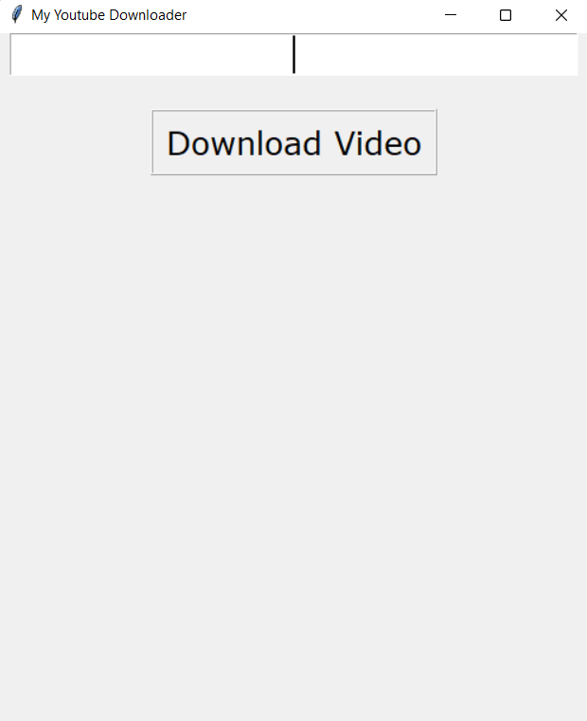
OUTPUTS
Using pytube, we are able to run the url of the video through and download the video without any files. The downloader downloads the video in the best possible video quality.

Slide 12
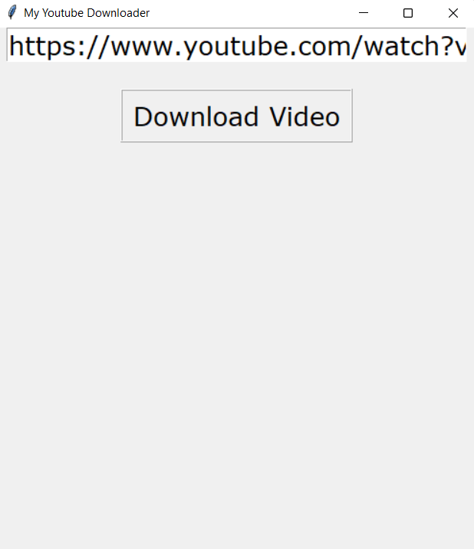
OUTPUTS
Using pytube, we are able to run the url of the video through and download the video without any files. The downloader downloads the video in the best possible video quality.

Slide 13
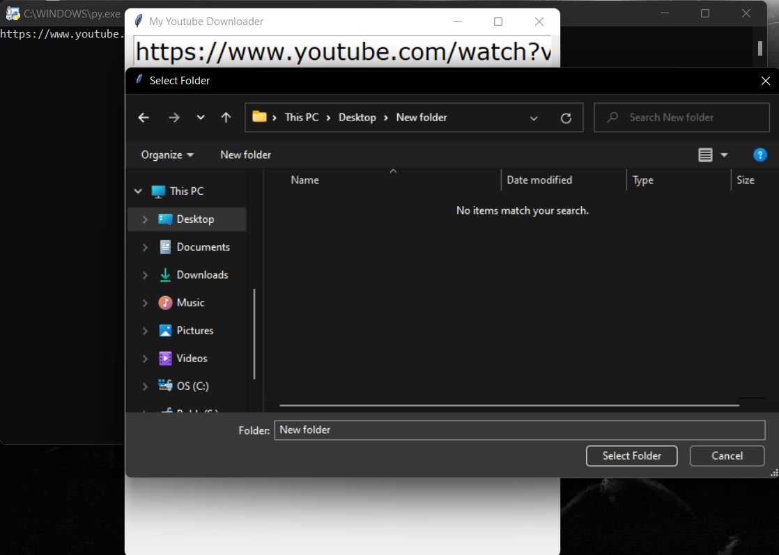
OUTPUTS
Using pytube, we are able to run the url of the video through and download the video without any files. The downloader downloads the video in the best possible video quality.

Slide 14
SUMMARY
With this project in python, we have successfully developed the youtube video downloader project using python. We used the popular Tkinter library that used for rendering graphics. We use the pytube library to download videos from youtube.
CONCLUSION
Python pytube library is simple and powerful. We can download YouTube videos in different resolutions, only audio, and all the videos from a playlist.

Slide 15
THANK YOU!

